Slide 1
One Time Pad
Data Communication
And
Network
Melvin Star Majaw
Sudam Sapkota

Slide 2
Contents
Characteristics
History
How does it work?
Unbreakable Encryption
The popular scientific explanation
The mathematical proof
References

Slide 3
Characteristics
The One Time Pad encryption method is a binary additive stream cipher, where a stream of truly random keys is generated and then combined with the plain text for encryption or with the ciphertext for decryption by an ‘exclusive OR’ (XOR) addition.
It is possible to prove that a stream cipher encryption scheme is unbreakable if the following preconditions are met:
The key must be as long as the plain text.
The key must be truly random.
The key must only be used once.
The One Time Pad implementation in mils electronics products fulfils all these requirements and therefore provides absolute protection for our customers’ sensitive information.

Slide 4
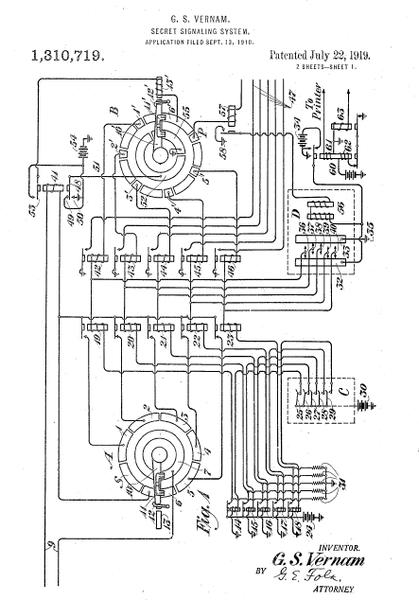
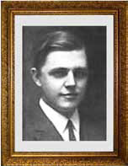
history
The One Time Pad encryption method is nothing new. In 1917, Gilbert Vernam invented a cipher solution for a
teletype machine. U.S. Army Captain Joseph Mauborgne realized that the character on the key tape could be
completely random. Together, they introduced the first One Time Pad encryption system.
Gilbert Vernam

Slide 5
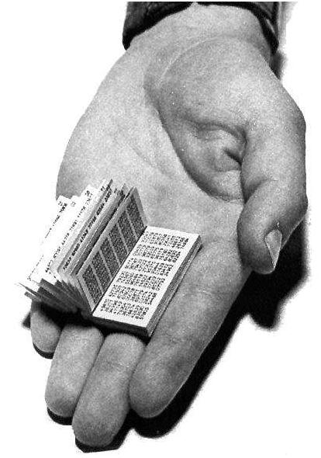
Another development was the paper pad system.
Diplomats had long used codes and ciphers for confidentiality. For encryption, words and phrases were converted to groups of numbers and then encrypted by using a OneTime Pad.
A ‘One Time Pad’

Slide 6
How Does It Work?
The encryption process
One Time Pad keys are used in pairs.
One copy of the key is kept by each user and the keys are distributed securely prior to encryption.
The confidentiality and authenticity of the One Time Pad keys are assured by continuous protection during their distribution and storage.
This guarantees that outsiders will not be able to misuse the key (e.g. by copying or altering the key during distribution).

Slide 7
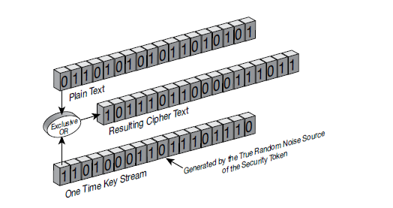
The Encryption Process

Slide 8
The Encryption Process
To encrypt plain text data, the sender uses a key string equal in length to the plain text. The key is used by mixing (XOR-ing) bit by bit, always a bit of the key with a bit of the plain text to create a bit of cipher text.
This cipher text is then sent to the recipient.
At the recipient’s end, the encoded message is mixed (XOR-ed) with the duplicate copy of the One Time Key and the plain text is restored.
Both sender’s and recipient’s keys are automatically destroyed after use, to ensure re-application of the same key is not possible.

Slide 9
Why is One Time Pad encryption unbreakable?
The popular scientific explanation
The mathematical proof

Slide 10
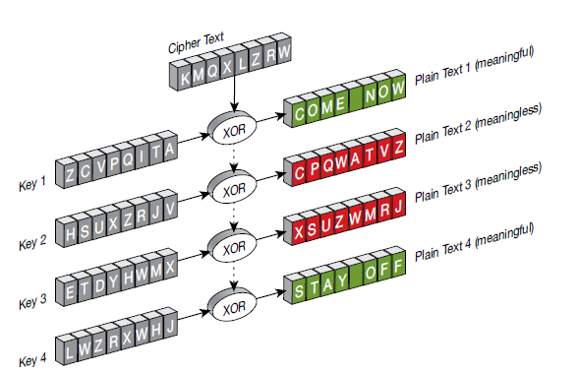
The popular scientific explanation
With One Time Pad encryption, the key used for encoding the message is completely random and is as long as the message itself.
That is why the only possible attack to such a cipher is a brute force attack.

Slide 11
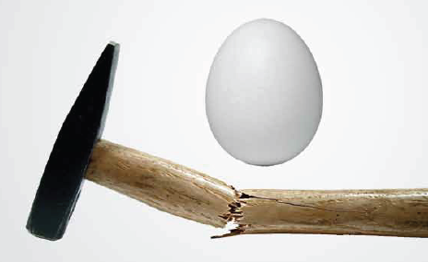
The popular scientific explanation
The ‘Brute Force’ attack
Brute force attacks use exhaustive trial and error methods in order to find the key that has been used for encrypting the plain text.
This means that every possible combination of key bits must be used to decrypt the cipher text.
The correct key would be the one that produces a meaningful plain text.

Slide 12
The popular scientific explanation
Unlimited computing power is useless
Let’s assume an eavesdropper has intercepted a One Time Pad encrypted message and that he has unlimited computing power and time.
A brute force attack would be very expensive for a plain text of reasonable size.
For example,
Typical e-mail messages are at least 200 bytes long, requiring the testing of 1.600 bits. Even if the eavesdropper is both willing and able to do this, the following paragraph will describe why unlimited computational power will not compromise the system.

Slide 13
The popular scientific explanation
Attackers must try every possible key
Since all One Time Keys are equally likely and come from a completely unpredictable noise source that is provably random, the attacker has to test all possible key strings.

Slide 14
The popular scientific explanation
Impossible to guess the right plain text
If he used every possible key string to decrypt the cipher text, all potential plain text strings with the same length as the original plain text data would appear.
Most of these potential plain text strings would not make sense; however, every meaningful string the same length as the original plain text data would also appear as a potential plain text string.
Without knowing the applied OTP, the eavesdropper has no way of finding out which meaningful string is the original plain text.
Thus, trying all possible keys doesn’t help the attacker at all, since all possible plain texts are equally likely decryptions of the cipher text.

Slide 15
Mathematical Proof
The probability of a key bit being 1 or 0 is exactly equal to ½.
The plaintext bits are not balanced. Let the probability of 0 be x and then the probability of 1 turns out to be 1-x.
Let us calculate the probability of ciphertext bits.
mi prob | Ki prob | Ci prob
0 x | 0 ½ | 0 ½ x
0 x | 1 ½ | 1 ½ x
1 1-x | 0 ½ | 0 ½ (1-x)
1 1-x | 1 ½ | 1 ½ (1-x)

Slide 16
We find out the probability of a ciphertext bit being 1 or 0 is equal to (½)x + (½)(1-x) = ½. Ciphertext looks like a random sequence.

Slide 17
Example
Suppose Alice wishes to send the message "HELLO" to Bob. Assume two pads of paper containing identical random sequences of letters were somehow previously produced and securely issued to both. Alice chooses the appropriate unused page from the pad.
H E L L O message
7(H) 4(E) 11(L) 11(L) 14(O) message
+ 23(X) 12(M) 2(C) 10(K) 11(L) key
= 30 16 13 21 25 message + key
= 4 (E) 16 (Q) 13 (N) 21 (V) 25 (Z) (message + key) mod 26
E Q N V Z → ciphertext

Slide 18
The ciphertext to be sent to Bob is thus "EQNVZ". Bob uses the matching key page and the same process, but in reverse, to obtain the plaintext. Here the key is subtracted from the ciphertext, again using modular arithmetic:
E Q N V Z ciphertext
4 (E) 16 (Q) 13 (N) 21 (V) 25 (Z) ciphertext
- 23 (X) 12 (M) 2 (C) 10 (K) 11 (L) key
= -19 4 11 11 14 ciphertext – key
= 7 (H) 4 (E) 11 (L) 11 (L) 14 (O) ciphertext – key (mod 26)
H E L L O → message

Slide 19
references
https://en.wikipedia.org/wiki/One-time_pad
http://www.cryptomuseum.com/manuf/mils/files/mils_otp_proof.pdf
https://www.lri.fr/~fmartignon/documenti/systemesecurite/3-OneTimePad.pdf
https://doc.lagout.org/security/Crypto/onetime.pdf

Slide 20
Thank you ☺

